Slide 1
Exploring Clustering Methods
Infant and Maternal Mortality Indicators
In Colombia
July 24, 2020
By Andrés Segura

Slide 2
Clustering
Reason? Objective?
For each indicator or disease:
1 model for Colombia
33 models for departments and DC
1100+ models for municipalities

Slide 3
Clustering

Slide 4
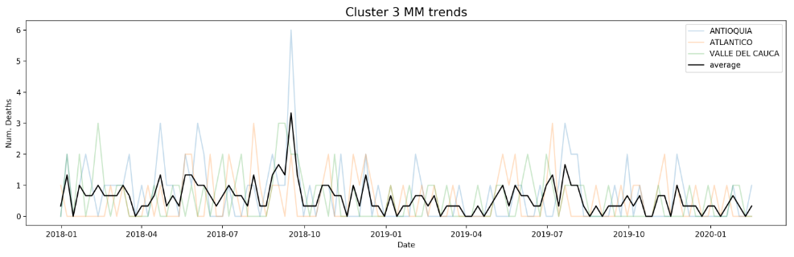
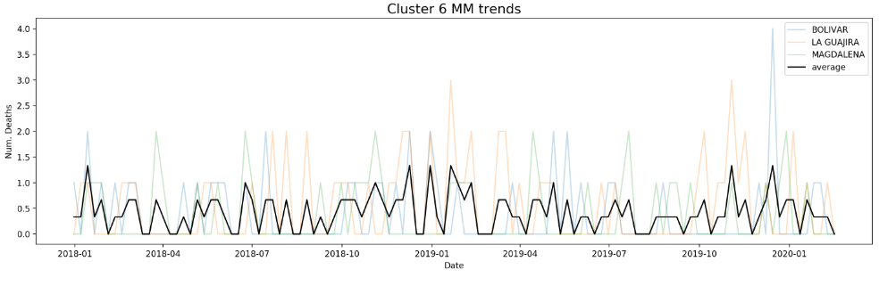
Clustering

Slide 5
Clustering Hyper-params
Data:
32 Departments + 1 DC
Period: 2018-2019 and 2017-2019
Direction
Horizontal (rows = departments & columns = 52 weeks)
Vertical (rows = date & columns departments)
GeoDemo data: Yes or No
Algorithms:
PCA: 2, 3, 4, or 5 PC
K-Means
Gaussian Mixture Model
Dynamic Time Warping (DTW)
Clusters:
4, 5, 6 and 7

Slide 6
Clustering
Metrics:
For Clustering:
min(distance intra-class) and max(distance inter-class)
For results:
normalized and weighted standard deviation

Slide 7
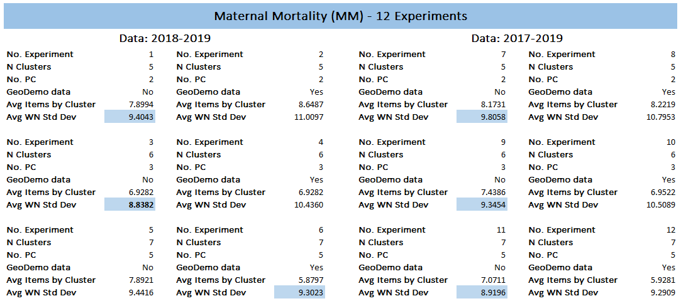
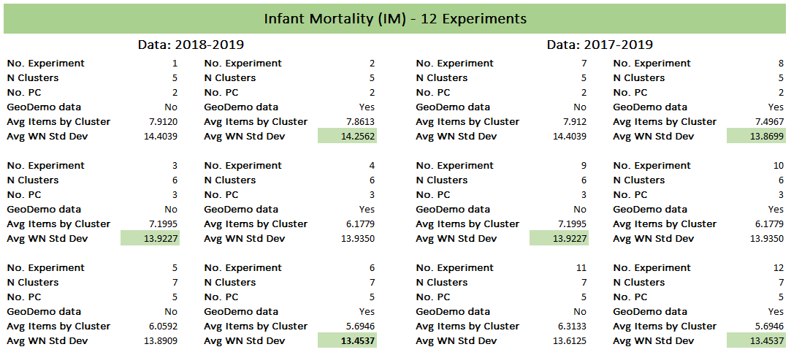
Clustering Results

Slide 8
Clustering Results
Suggestion?
Test all hyper-parameter (HP) combinations for each dataset and cluster with the hyper-params that has the lowest WNSD.

Slide 9
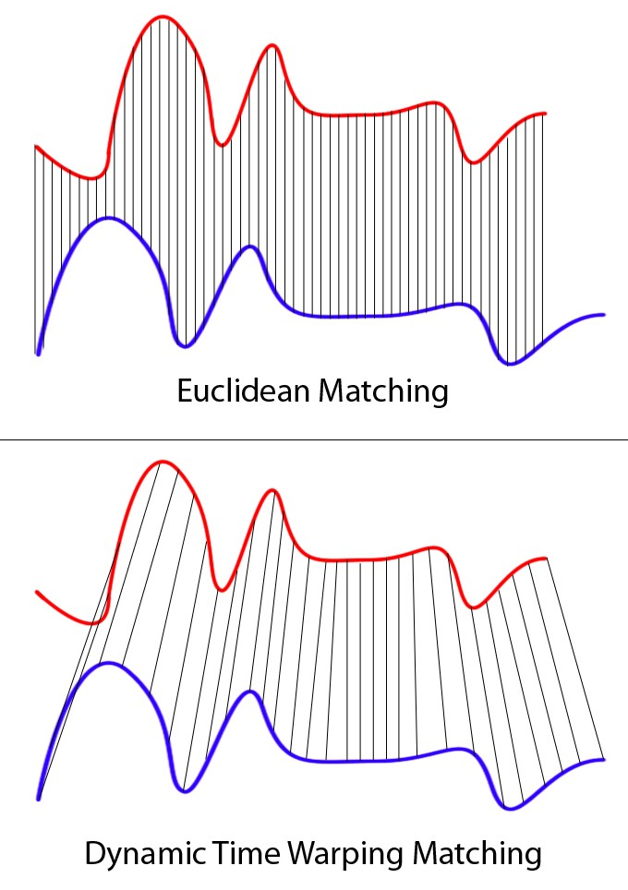
Examples
Algorithms:

Slide 10
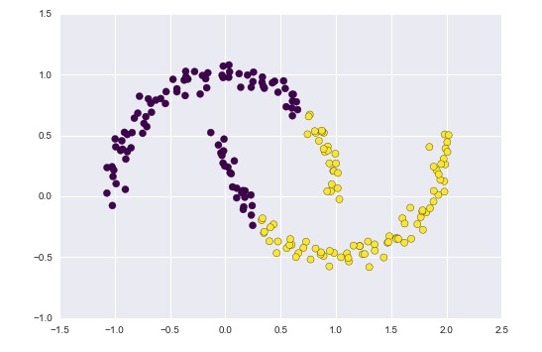
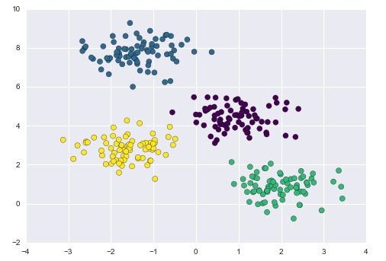
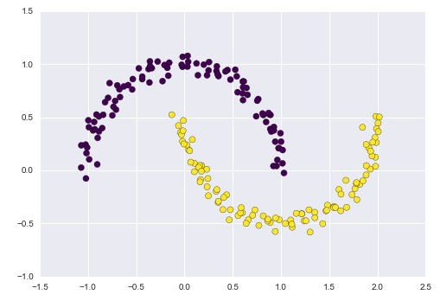
Examples
Algorithms:
K-Means:
GMM:

Slide 11
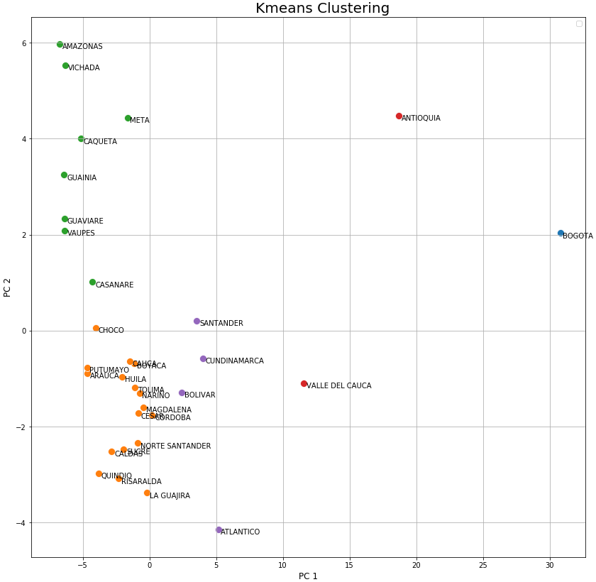
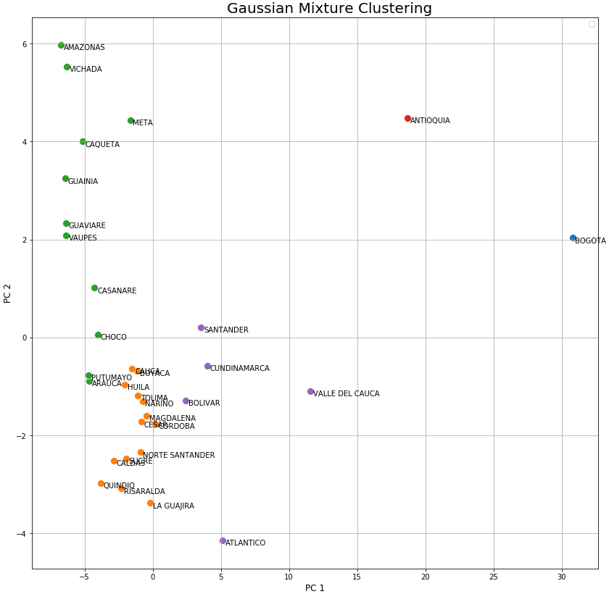
Examples
Algorithms:

Slide 12
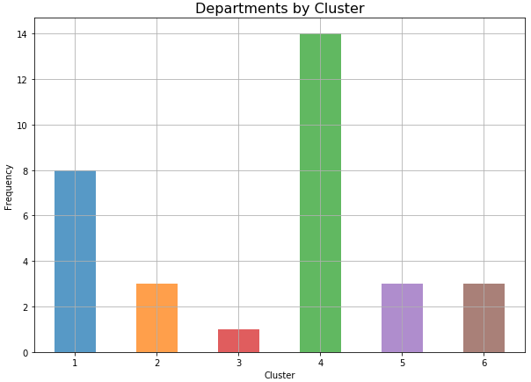
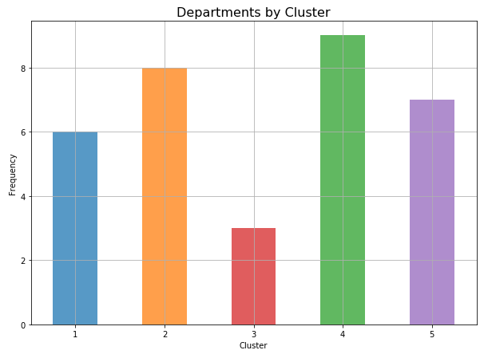
Examples
Clustering Sizes:
PCA + K-Means DTW

Slide 13
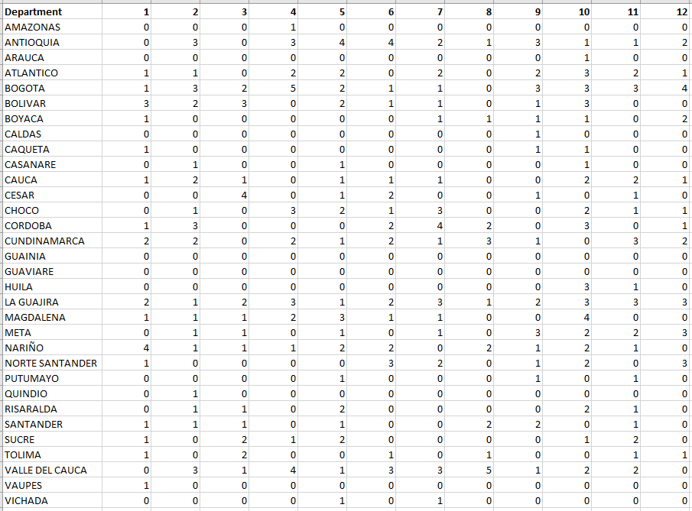
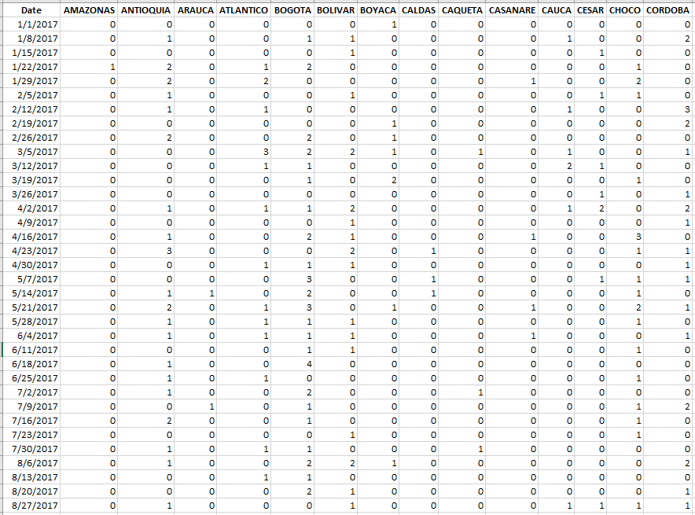
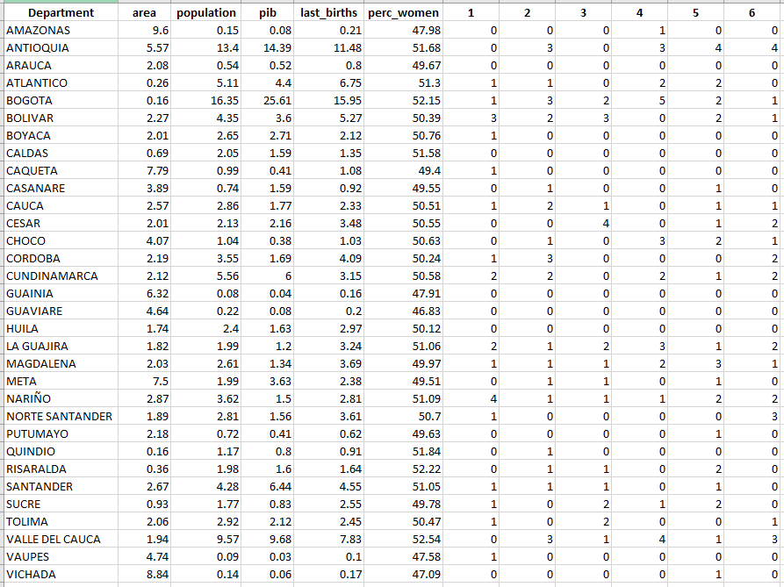
Examples
Dataset:
Basic Dataset+ GeoDemo
Basic Dataset
Pivoted Dataset

Slide 14
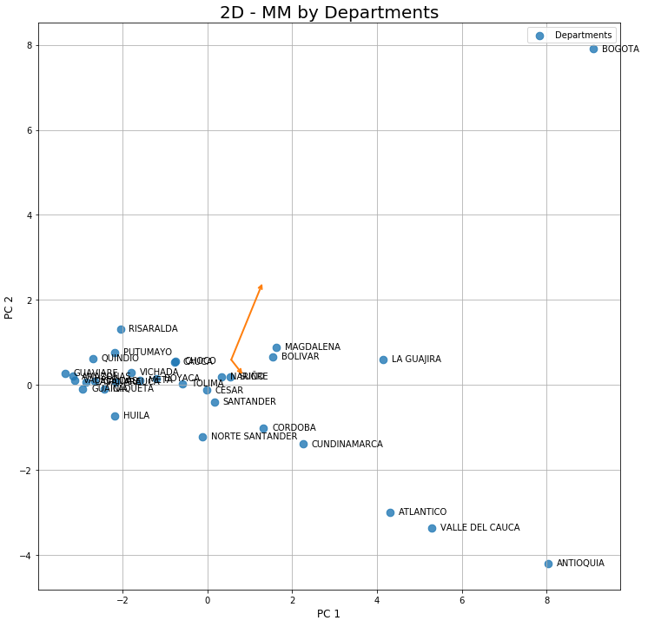
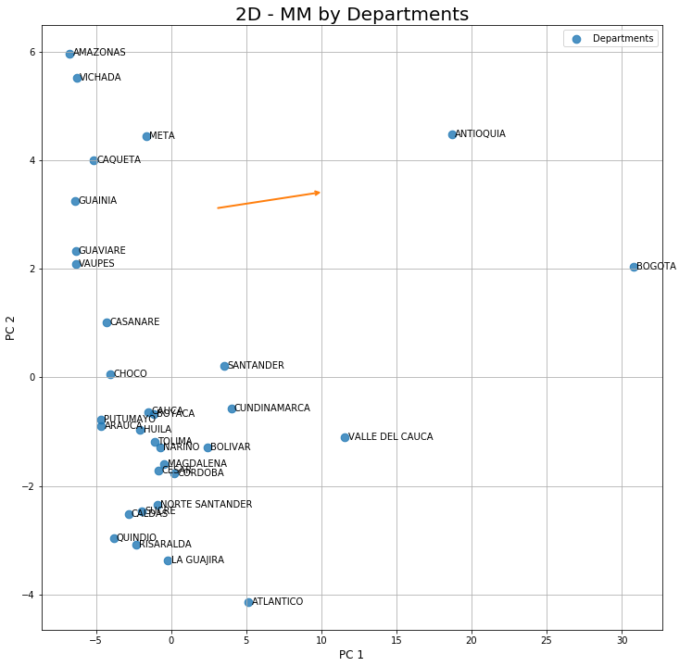
Examples
Dataset:
w/o GeoDemo
with GeoDemo

Slide 15
Let’s go to Jupyter Notebook
and thank you!

